Slide 1
Machine Learning Assignment 1
Abhi Raj
ENG19CS0007
Section: A

Slide 2
MAchine Learning
Machine Learning is the field of computer science that uses statistical techniques to give computer systems the ability to learn with Data, without being explicitly programmed.
In machine learning we have to give input and output to the system and the computer will generate the programme.

Slide 3
Types of MAchine learng.
Machine learning is of three types:
Supervised learning.
Classification.
Regression.
Unsupervised learning.
Reinforcement learning.

Slide 4
Supervise Learning
Supervised learning is learning from someone, it contains features (input) and labels (output).
we are learning from our teacher in the class.
Kids learns how to speaks something from parents.
A boy learn swimming from his swimming trainer.
A fighter pilot learns how to fly the aircraft by his senior pilot.

Slide 5

Parents teaching their kids something is supervised learning.

Slide 6

Teacher Teaching Kids, also A supervised learning.

Slide 7
TYpes of Supervised learning.
•Classification – Is the type through which the algorithm can classify between two options like yes or no , true or false etc. Different types of classification algorithms are Logistic Regression , Decision Tree , Random Forest , SVM, KNN etc..
•Regression – is the type of algorithm through which the model can predict the outcomes with the present input and test datas. Different types of regression are linear regression etc.

Slide 8
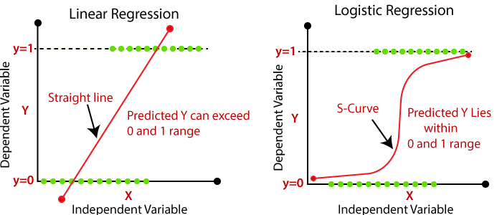
Linear regression
•Is the algorithm used to predict the output when an input is given. Before that the sample in input and output should be fed into the system as features and labels.
•Example 2 = 4, 3=6, 4=8 , 5=10 so that makes 9=18(that is y=2x)

Slide 9
Logistic regression
•Is the algorithm used to classify the given input to a specific output that is like yes or no, true or false etc.
•Example 40 marks is passing marks then when a input is given the algorithm classifies it to be pass or fail.

Slide 10
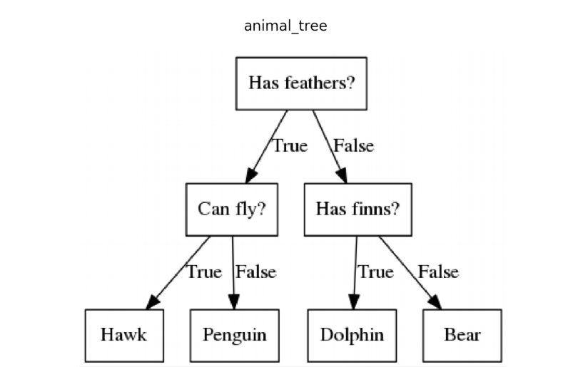
Decision tree
•Is the algorithm in which the decision is made based on two options which will further decide the future input in the datasets. That is basically each node will have two options .

Slide 11
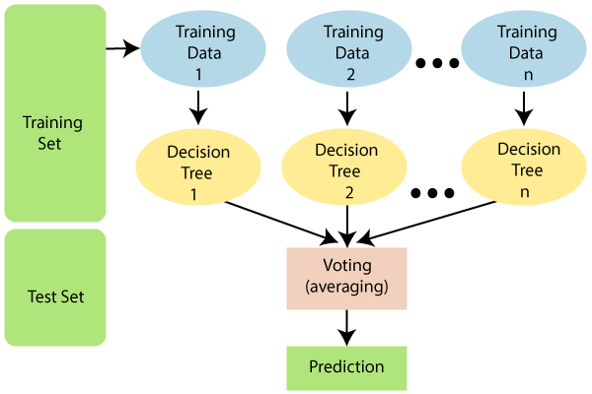
Random forest
•Is the algorithm in which random inputs(trees in the forest) are taken and based on the highest common output the output is found.

Slide 12
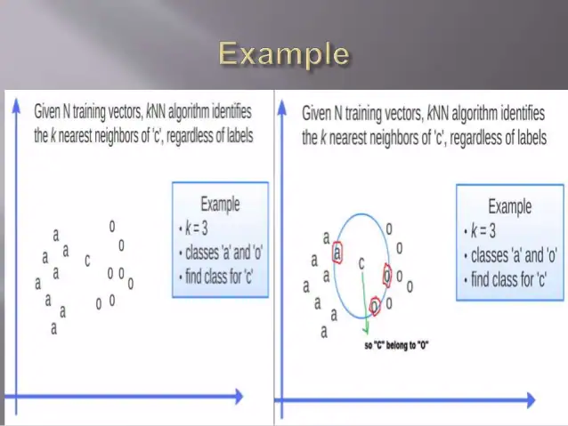
knn
•In this algorithm the output is got with the help of the nearest neighbour. The value of K is the most crucial part in this algorithm.
•Example we can classify between an apple and orange using this.

Slide 13
svm
•Is the algorithm in which we plot each data as just a point in n – dimensional space. Where n is the number of features(input or dataset). Then we classify the output from the given space.

Slide 14
Unsupervised Learning
It is learning by own. In this type of learnig we did not need someone who can teach something.

Slide 15
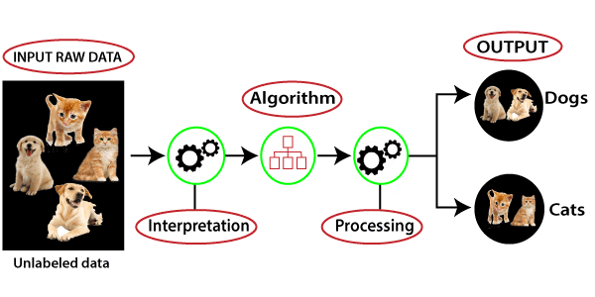
In this we can see that a number of unlabelled data are being feede to the system and by processing those data system distinguish the data in different group based on their features. In this system do all the work by own that is unsupervised learning.

Slide 16
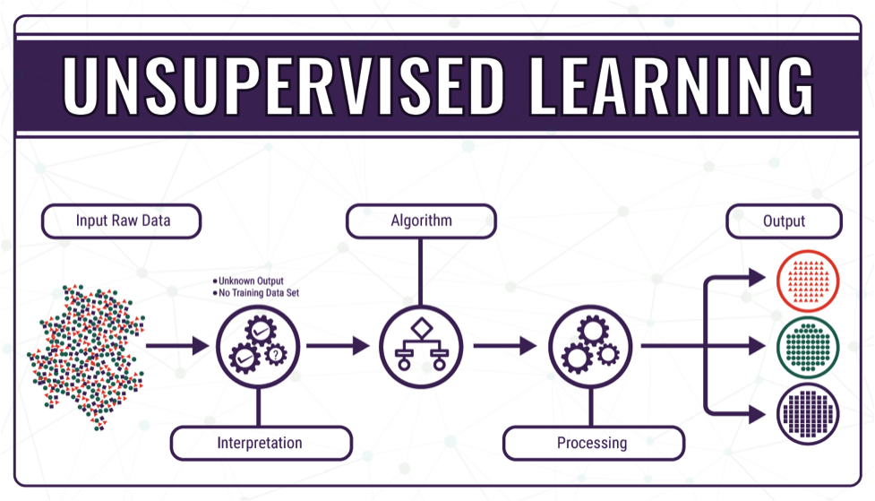

Slide 17
Reinforcement Learning.
In this type of machine learning rewards and panelty are taken in account. If you do the work you will get reward and if not then you will get panelty.
Ex:
Just like a kid get toffy for doing homework and punishment for not doing, or In competative MCQ exam the student will get 4 marks for every correct answer and 1 marks will be deduced for every wrong answer.

Slide 18
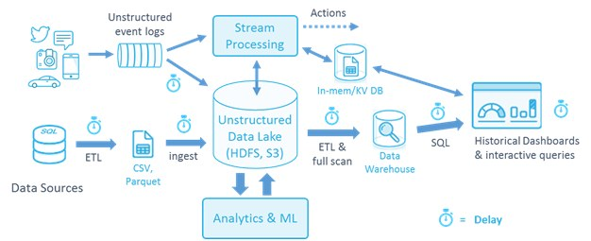
Data Warehouse
•A data warehouse is the collection of all the data(database) and ELT(loader) and other applications

Slide 19
Data Mining
•The process of taking data from the data warehouse.
•In other words the process of retrieving data from Data Warehouse

Slide 20
Collab Link
https://colab.research.google.com/drive/1XEwwh_Ry2165Y7d6MfE-zWdO6HEzTiWD?authuser=1#scrollTo=9ZLDgk1dIBfm

